Slide 1
Covid 19 Spread:Based on World Stats and United States
Presented by “The Data Dreamers”
Jimmy Walsh, Sequoyah Cooper, Mathew Lack, Shweta Shukla-Goyal, Liz Stevens

Slide 2
Motivation & Summary

Slide 3
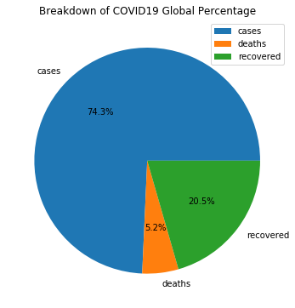
We were interested in COVID 19 as a subject because of its global impact and relevance right now.
We took various approaches to understand how COVID 19 is spreading and impacting the world. We also wanted to narrow down more specifically on the US.
Notes:
Liz- let’s increase font size

Slide 4
Questions & Data

Slide 5
Questions & Hypotheses
What does the COVID19 pandemic look like worldwide and what is the US’s role in its spread?
- Hypothesis: The US dominates COVID-19 cases worldwide.
Is there a relationship between the spread of the pandemic and socio-economic factors of people infected?
Does poverty rate correlate with positive cases and total deaths?
Hypothesis: Poverty rates increases positive cases and total deaths by state.
Does hospital access (available beds) impact number of positive cases or total deaths?
Hypothesis: Is lack of hospital beds correlated with greater # of fatalities.
Does population density impact number of positive cases or total deaths?
Hypothesis: States with big cities will have a greater number of cases and deaths.
Is there a relationship between states successfully practicing social distancing and reducing the amount of confirmed cases?
Hypothesis: States with more aggressive social distancing practices reduce number of positive cases and deaths.
Notes:
Liz

Slide 6
Data Sources
These are the sources we used to help answer our questions:
API for live information about COVID-19*
-GET https://coronavirus-19-api.herokuapp.com/all -> global info
-GET https://coronavirus-19-api.herokuapp.com/countries -> all countries info
*The api part is a fork from https://github.com/NovelCOVID/API. An ionic frontend is
showing the info nicely at https://coronavirus-19-api.herokuapp.com/
-State Data API
- https://covidtracking.com/api
States Current Values - /api/v1/states/current.json
-Hospital Data CSV (# of hospitals & location of hospitals by county & state): https://www.kaggle.com/roche-data-science-coalition/uncover#definitive-healthcare-usa-hospital-beds.csv
-Socio-Economic/Poverty data CSV: https://research.stlouisfed.org/resources/covid-19/preliminary/covid-19-households-financial-distress-part-2
-https://www.ers.usda.gov/data-products/county-level-data-sets/
-Social Distancing Rankings (by state): https://wallethub.com/edu/most-aggressive-states-against-coronavirus/72307/
Notes:
Shweta

Slide 7
Data Cleanup & Exploration

Slide 8
Exploration: We researched many sites for data exploration. We located reliable data (out of the many sources providing COVID 19 data right now). However, we had to create our own CSV files for certain datasets because the data was not available for download in a proper format.
Cleanup: We each created separate dataframes and merged into two main dataframes to make working with the data easier.
Insights: We realized the importance of understanding data at the beginning of analysis. For example, our Hospital Data we thought was cleaned, but deeper analysis showed errors we needed to fix.
Notes:
Seqyoyah

Slide 9
Data Analysis

Slide 10
We referred back to our questions and discussed available data we could use to answer questions in our proposal. Our team divided up graphics to help answer questions, and reconveigned to discuss what these graphs showed us compared to the original hypotheses.
We decided on additional graphics as more questions arose from the initial findings.
For example, our original data had a ranking for each state’s aggressiveness towards “shelter-in-place” orders, and we later found additional data that categorized each state’s response on a letter grade scale (A-F).
We also added an additional scatter plot to see the relationship between total tests and number of deaths, which showed test shortages could lead to uncounted deaths.
Notes:
Jimmy

Slide 11
Country Graphs

Slide 12
Discussion
What does the COVID19 pandemic look like worldwide and what is the US’s role in its spread?
Hypothesis: The US dominates COVID-19 cases worldwide.
Conclusion: We were able to discover that the US plays a dominant role in the number of cases and deaths associated with COVID19, and furthermore that a few states contribute to the majority of the number of cases and deaths (New York & New Jersey).
Notes:
Shweta

Slide 13
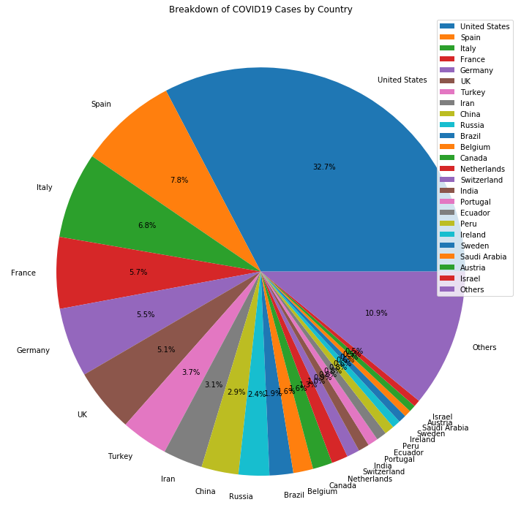
Cases by Country
How many cumulative cases is the world dealing with?
United States has the highest no. of cases, followed by Spain and Italy.
Also, the percent of countries with less than 1% is accounts for %11.83 of total cases.
Notes:
Shweta

Slide 14
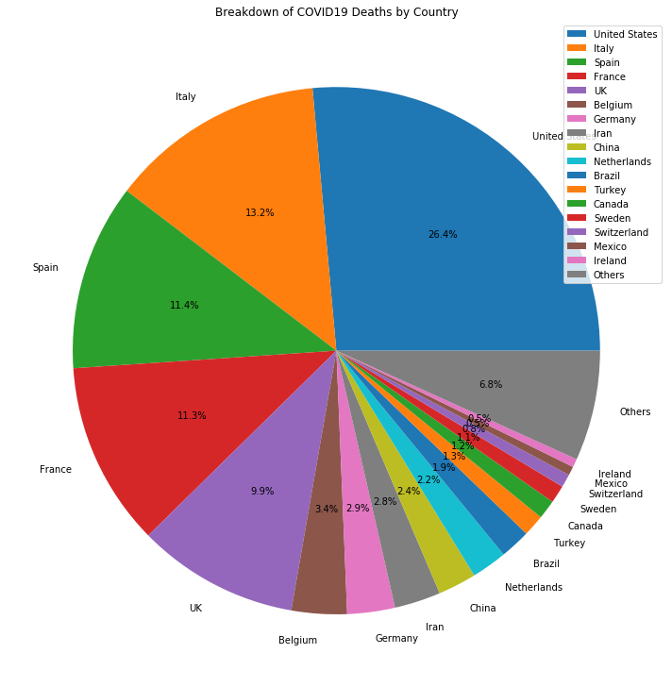
Deaths by Country
How many cumulative deaths have occured around the world?
United States has the highest death rate, followed by Italy and Spain.
Also, the percent of countries with less than 1% is 7.12 percent of total deaths.
Notes:
Shweta

Slide 15
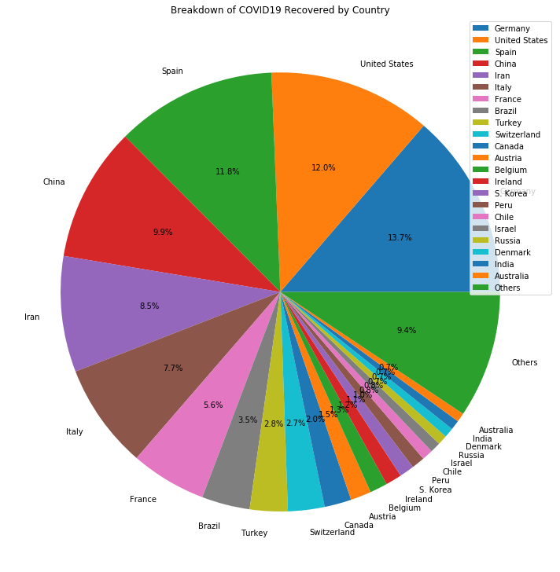
Recovered by Country
How many cumulative recoveries have been achieved around the world?
Germany has the highest recovered rate, followed by Spain and United States.
Also, the percent of countries with less than 1% makes up 8.73% of total recoveries.
Notes:
Shweta

Slide 16
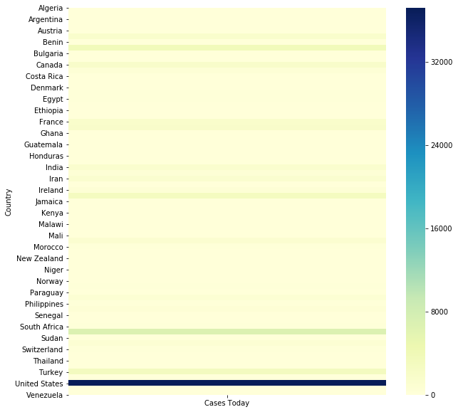

Heatmap: Today’s New Cases by Country (4/24/20)
How many countries have large new cases on daily basis? Can we frame them all in a certain spectrum?
United States is on a very high spectrum, making it the worst affected country by Covid19.
Countries like South Africa, and other geographic areas in the vicinity have approached
the middle spectrum!
Notes:
Shweta

Slide 17
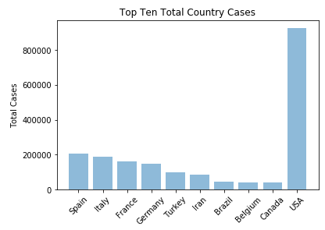
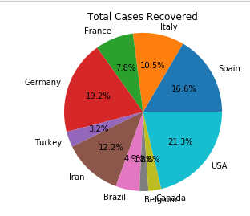
Top Ten Countries with the most Confirmed Cases
Interesting to see how having X amount of confirmed Cases does not correlate to recovery.
Notes:
Matt

Slide 18
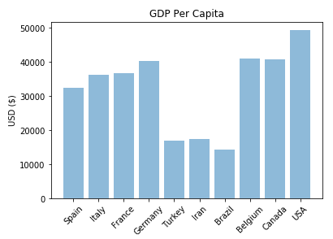
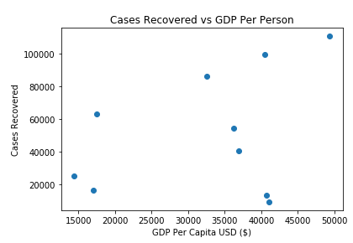
GDP Per Capita and Coronavirus Recovery
Wealth of a nation also does not correlate (necessarily) to patients recovering.
Notes:
Matt

Slide 19
State Graphs

Slide 20
Discussion
Additional Finding: New York and New Jersey Dominate the US for total cases and deaths. The percentage of deaths and cases that come directly from the New York and New Jersey account for almost 43% of cases and over 48% of deaths for all of the United States.
Notes:
Sequoyah

Slide 21
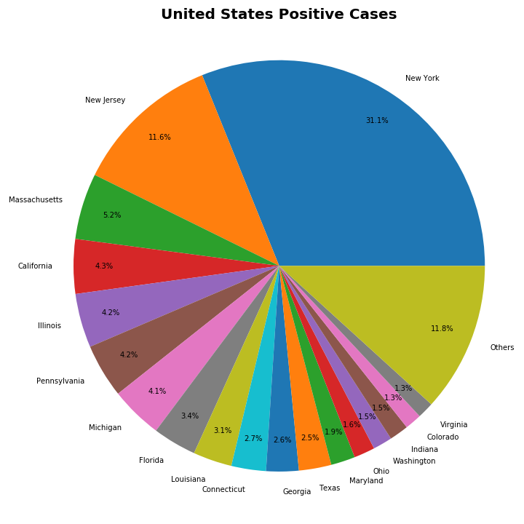
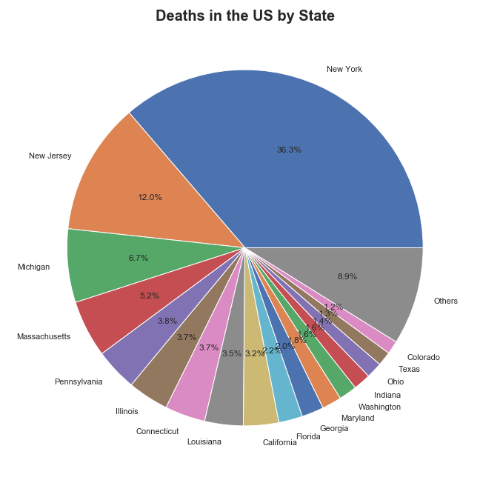
Breakdown of US Cases and Deaths by State
These pie graphs further highlights how New York and New Jersey dominate other states in cases/deaths. Michigan is 6th in cases, but 3rd in total deaths. California is 4th in cases, but 9th in deaths.
Notes:
It is interesting to note the percentage of deaths and cases that come directly from the New York and New Jersey which account for almost 43% of cases and over 48% of deaths.
Sequoyah

Slide 22
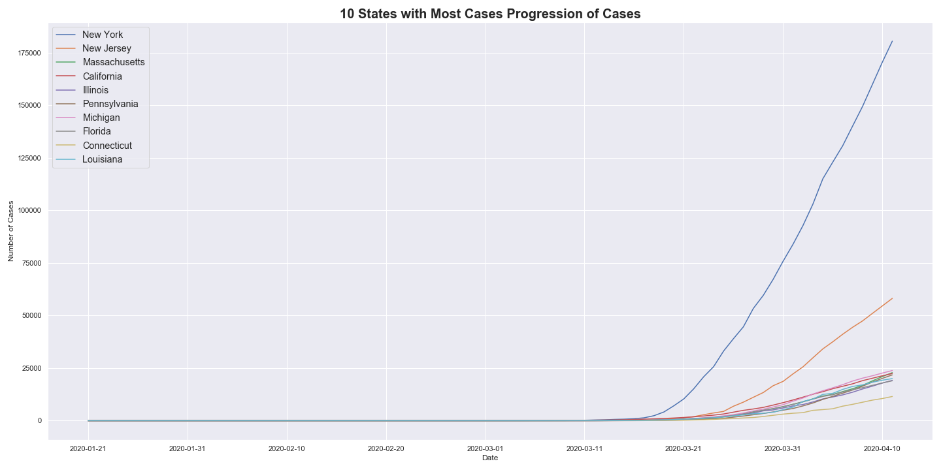
US Cases Over Time (Top 10 Total)
This graph shows the rate of growth of cases in New York and New Jersey far exceeds other states.
Notes:
Jimmy - This graph highlights the rapid growth in Cases in New York and New Jersey compared to the rest of the US

Slide 23
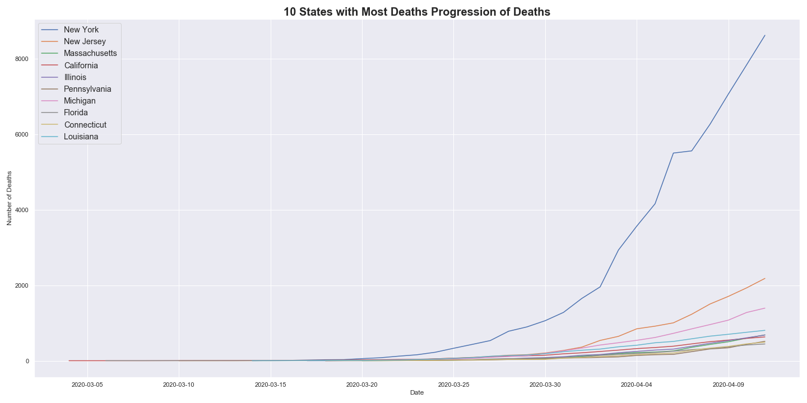
US Deaths Over Time (Top 10 Total)
This graph shows the rate of growth deaths in New York and New Jersey far exceeds other states.
Notes:
Jimmy- This highlights the same in deaths which is expected based on the strong correlation between cases and deaths, but It is interesting to note flat section in the New York Curve which was the period that we thought NY was past its peak

Slide 24
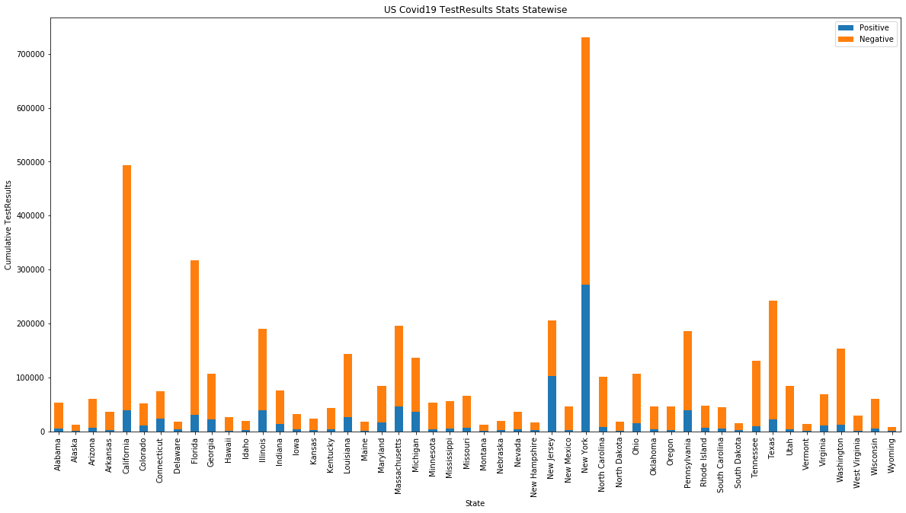
Bar Chart based on US Test Results
Is there a way to compare cumulative testing results with reference to each state?
California, New York, New Jersey, Florida, Texas are way ahead in testing compared to other states. They're also having comparable positives with respect to each other.
Notes:
Shweta

Slide 25
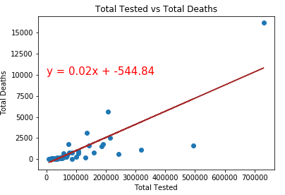
Scatter plot – US Test Results vs Deaths
How are the test results helping to get up-to-date death counts and classified death reasons?
The correlation between Total Tested and Total Deaths is 0.81, which is very strong.
-Test shortages could lead to uncounted deaths.
-Death reasons could be misclassified in the absence of test results.
Notes:
Shweta

Slide 26
Discussion
Does population density impact number of positive cases or total deaths?
Hypothesis: States with big cities will have a greater number of cases and deaths.
Conclusion: To address this question we looked at total state population compared to confirmed cases and deaths. There There is a weak positive linear correlation between state population and both confirmed cases/deaths. If we had time, we could have looked at the average population density of cities across the state.
Notes:
We looked at how population size was related to the number of deaths and cases. Unfortunately after doing so we discussed that this isn’t able to effectively answer our question of interest. We would need to explore individual city cases.

Slide 27
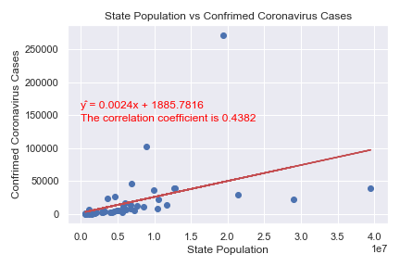
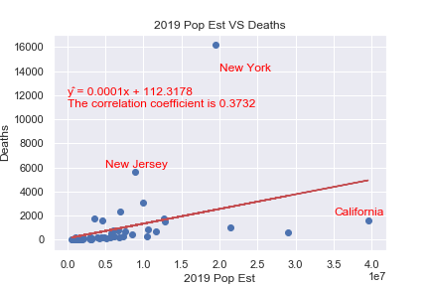
Correlation between Population of States and Cases/Deaths
There is a weak positive linear correlation between state population and both confirmed cases/deaths.
Notes:
Jimmy
It is interesting to note the percentage of deaths and cases that come directly from the New York and New Jersey which account for almost 43% of cases and over 48% of deaths.

Slide 28
Discussion
Is there a relationship between states successfully practicing social distancing and reducing the amount of confirmed cases?
Hypothesis: States with more aggressive social distancing practices reduce number of positive cases and deaths.
Conclusion: Analysis revealed that states with more aggressive “stay at home” measures did not have less COVID-19 deaths compared to states with less aggressive “stay at home” measures.
Notes:
Liz

Slide 29
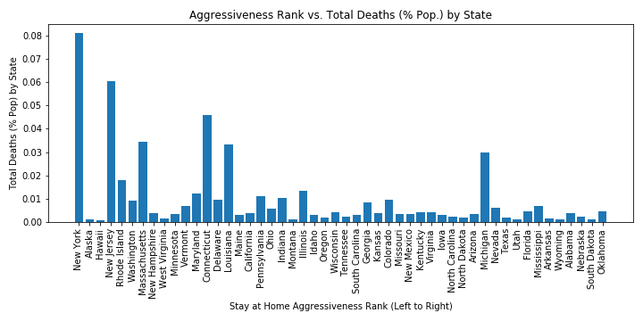
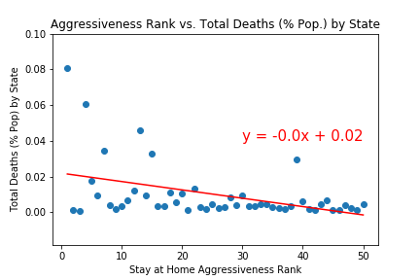
Total Deaths by State “Stay At Home” Aggressiveness Rank
Analysis revealed that states with more aggressive “stay at home” measures did not have less COVID-19 deaths compared to states with less aggressive “stay at home” measures.
Notes:
Liz: r squared value equals: 0.1873334565399271

Slide 30
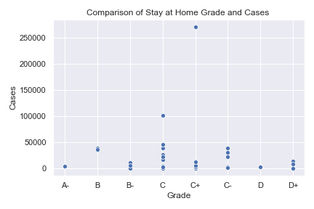
Stay At Home Order
We were unable to draw a conclusion from this additional analysis. Further showing that “stay at home” responsiveness does not have a significant relationship with total number of COVID 19 cases.
Notes:
Liz

Slide 31
Discussion
Does hospital access (available beds) impact number of positive cases or total deaths?
Hypothesis: The lack of hospital beds is correlated with greater # of fatalities.
Conclusion: There is no significant relationship between the number of doctors, the number of hospital beds, or the number of ICU beds utilized (%) and the total number of COVID 19 cases/deaths. This leads us to assume the spread of COVID 19 is not prevalent in the US because of a lack of healthcare resources to fight the pandemic.

Slide 32
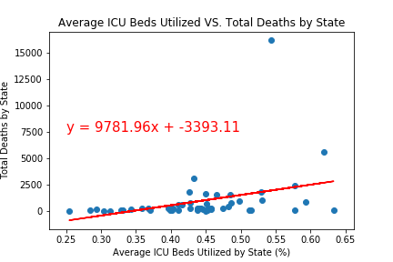
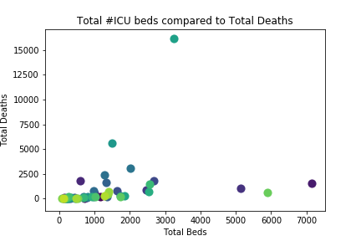
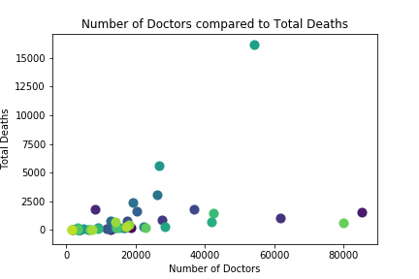
Healthcare Resources & Spread of COVID-19
Our Analysis found no significant relationship between # of ICU beds utilized, # of hospitals, or # of beds available and total deaths by state.
Notes:
Sequoyah

Slide 33
Discussion
Does poverty rate correlate with positive cases and total deaths?
Hypothesis: Poverty rates increases positive cases and total deaths by state.
Conclusion: In looking at scatter plots comparing a state’s poverty rate to the number of cases and the number of deaths there is no pattern in the data.
Notes:
Jimmy- We wanted to explore the effect of poverty on cases and deaths.

Slide 34
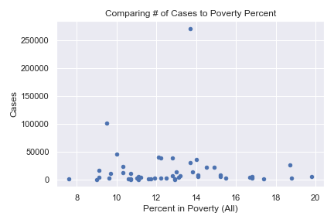
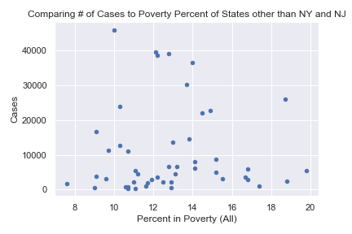
Does Poverty Impact Cases?
From this we can see that there is a weak correlation between poverty and the number of cases.
Notes:
Jimmy

Slide 35
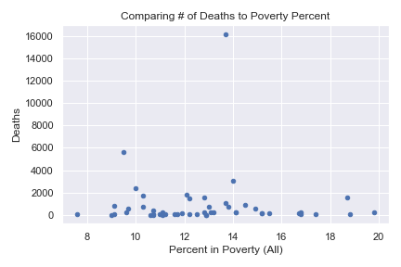
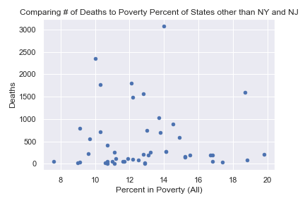
Does Poverty Impact Deaths?
From this we can see that there is a weak correlation between poverty and the number of cases.

Slide 36
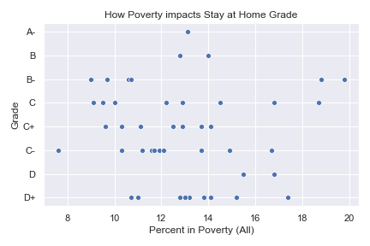
Poverty on Stay At Home Order
There doesn’t appear to be a correlation between the percent of a state living in poverty and the states stay at home grade.
Notes:
Jimmy

Slide 37
Post Mortem

Slide 38
Challenges
We faced challenges from the beginning because due to our approach for data collection. We started with a lot of data on a global level, and then narrowed down to a state level. In the end we did not have time to dig in with advanced statistical analysis on our broad topic.
Our team had to work through a lot of complications caused by using Git. We learned a lot in the process, but now know to always save work!
Finding appropriate data to answer our questions of interest proved to be more difficult than expected, so we had to adjust our expectations.
Finding an API with documentation that we understood was no easy task! Additionally, one of the API’s we used for state data changed output format. This impacted our data and graphs the last minute. However, our conclusions remained the same.
Notes:
Liz

Slide 39
Questions

